Slide 1
Feature Points,
Local Invariant Descriptors
CSCI 4150/6050: Computer Vision

Slide 2
Reminder: Window-based Features
Takes in whole image or patches of image, then tries to determine image features using
  Templates
  Voting Systems (Hough Transform)
  Histograms
  Gradient Information
These methods tend to be slow and not robust to changes in the image.

Slide 3
Do we need the whole image?

Slide 4
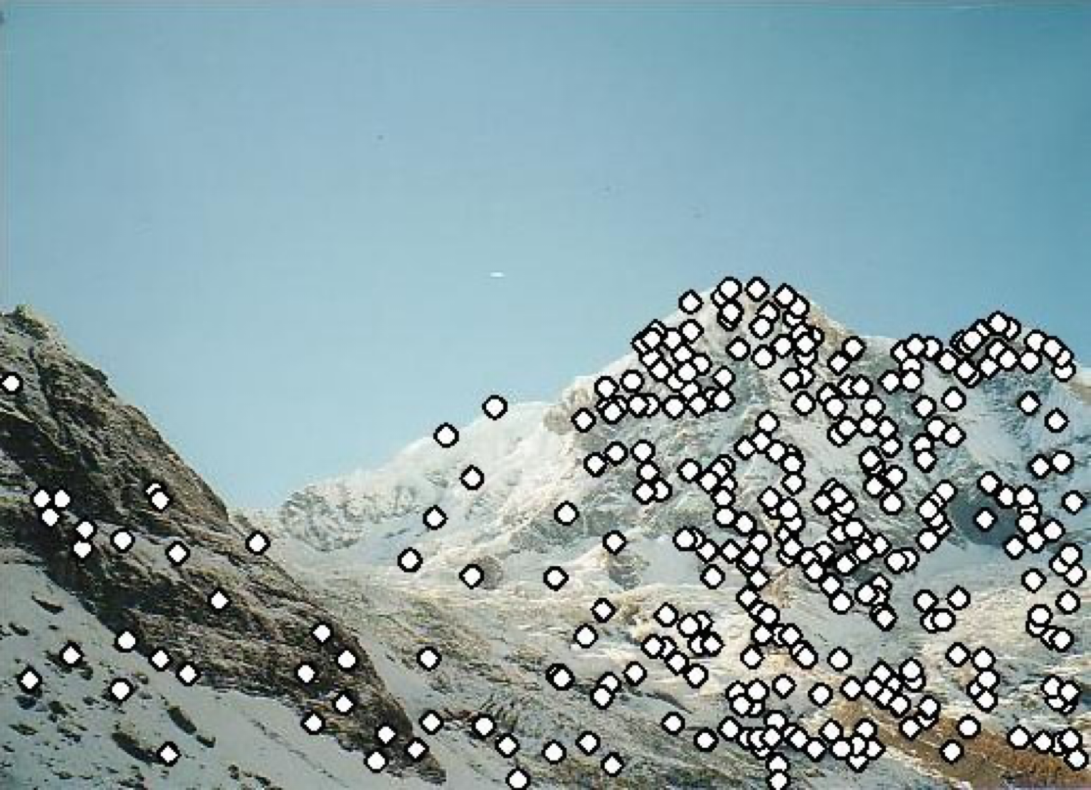
Feature Points
Useful to identify key points for matching between images
Goal: detect (some of) the same points in multiple images with common content
Applications:
  Aligning multiple images
  Detection
  Recognition
  and many more…

Slide 5
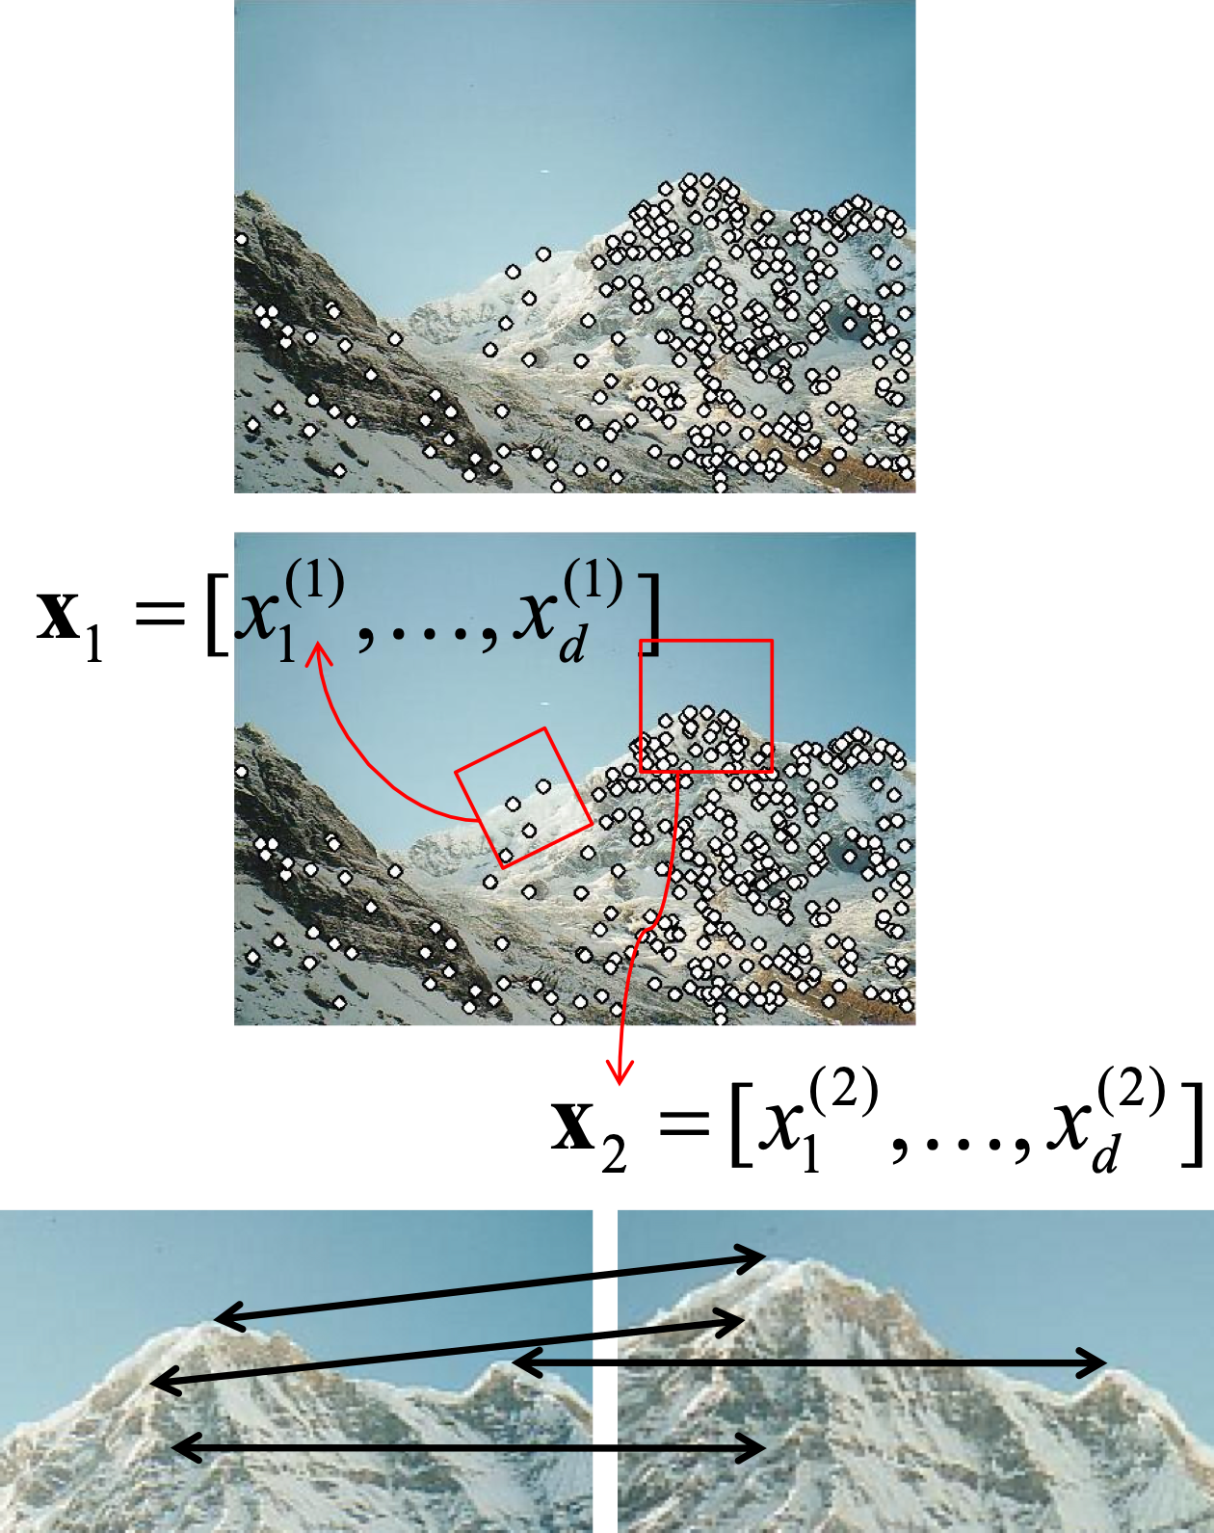
Feature Points
Typical process:
  Detection:
  identify points of interest
  Description:
  extract feature vectors
  Matching:
  determine correspondence

Slide 6
Feature Points
Typical process:
  Detection:
  identify points of interest
  Description:
  extract feature vectors
  Matching:
  determine correspondence

Slide 7
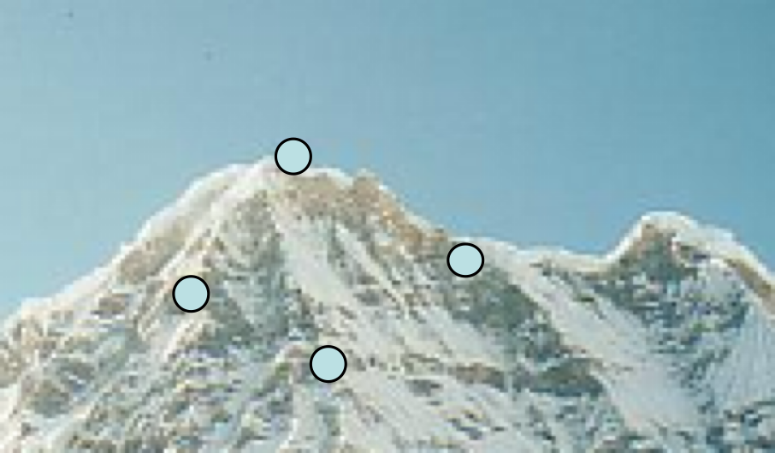
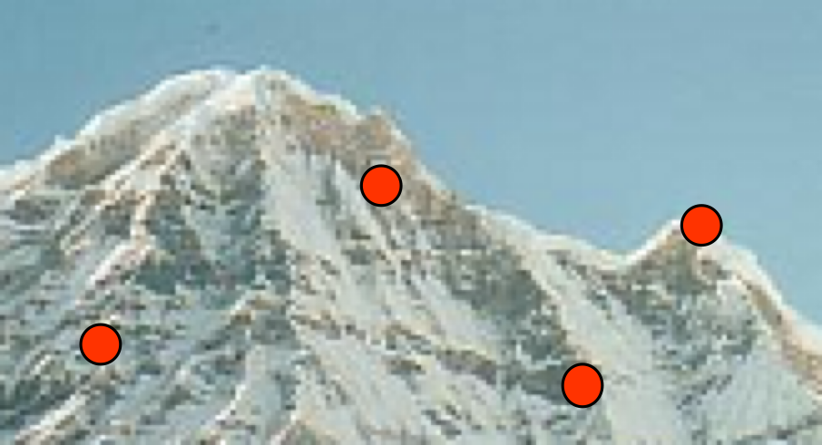
Feature Points
What makes a good feature point?
  Easy to detect
  Repeatable:
  find some of the same points in multiple images independently
  Distinctive:
  reliable matching of descriptions
No chance to find true matches!

Slide 8
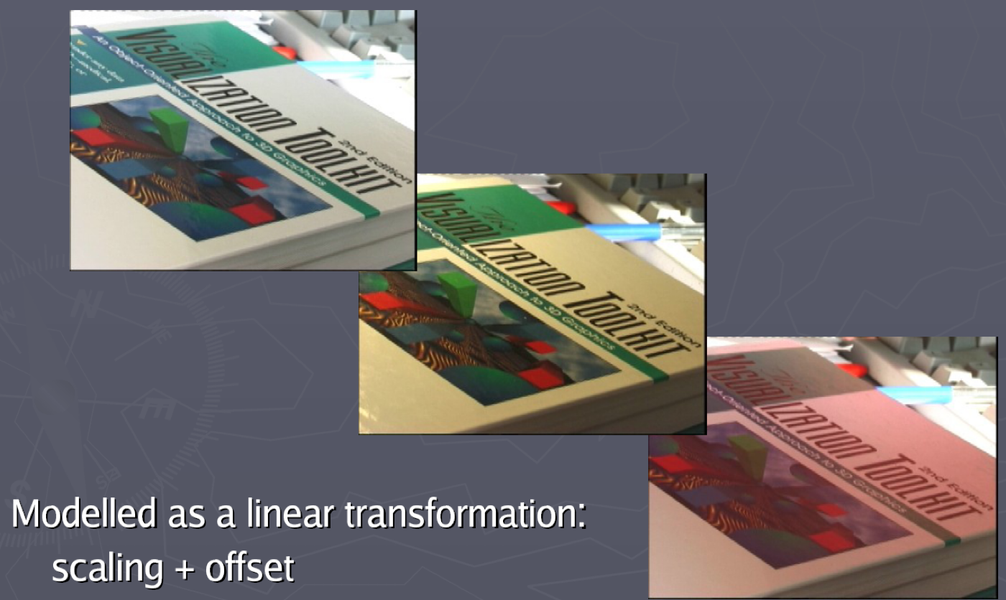
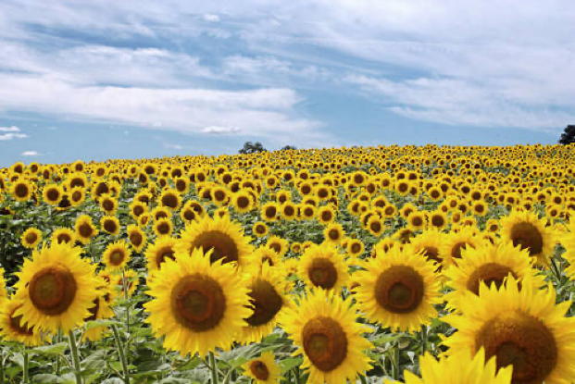

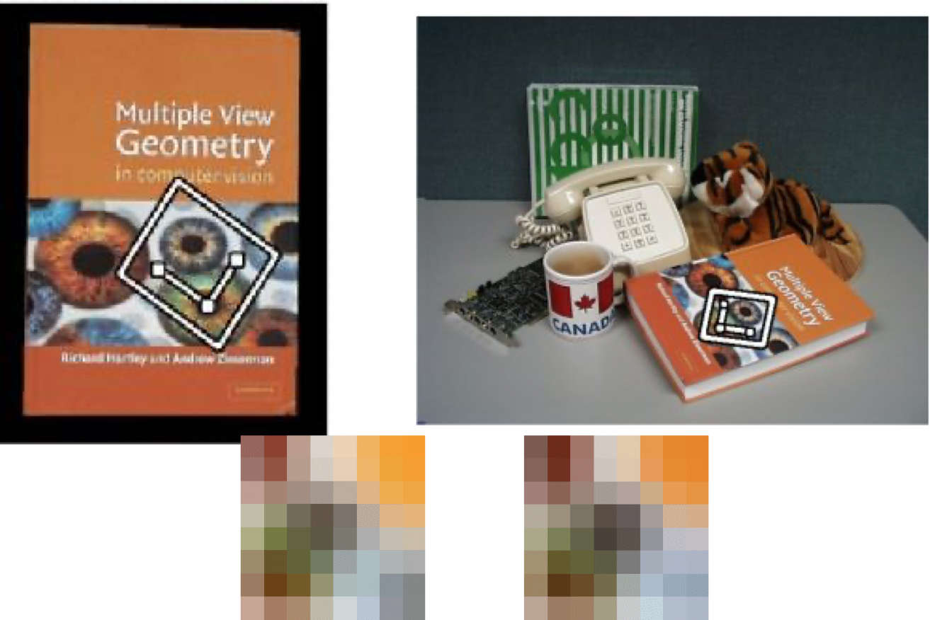
Reminder: Invariance
Invariance: the degree to which some feature stays the same under different image transformations
  Translation (position)
  Rotation
  Scale
  Perspective
  Illumination
For robustness it is important to be as invariant as possible

Slide 9
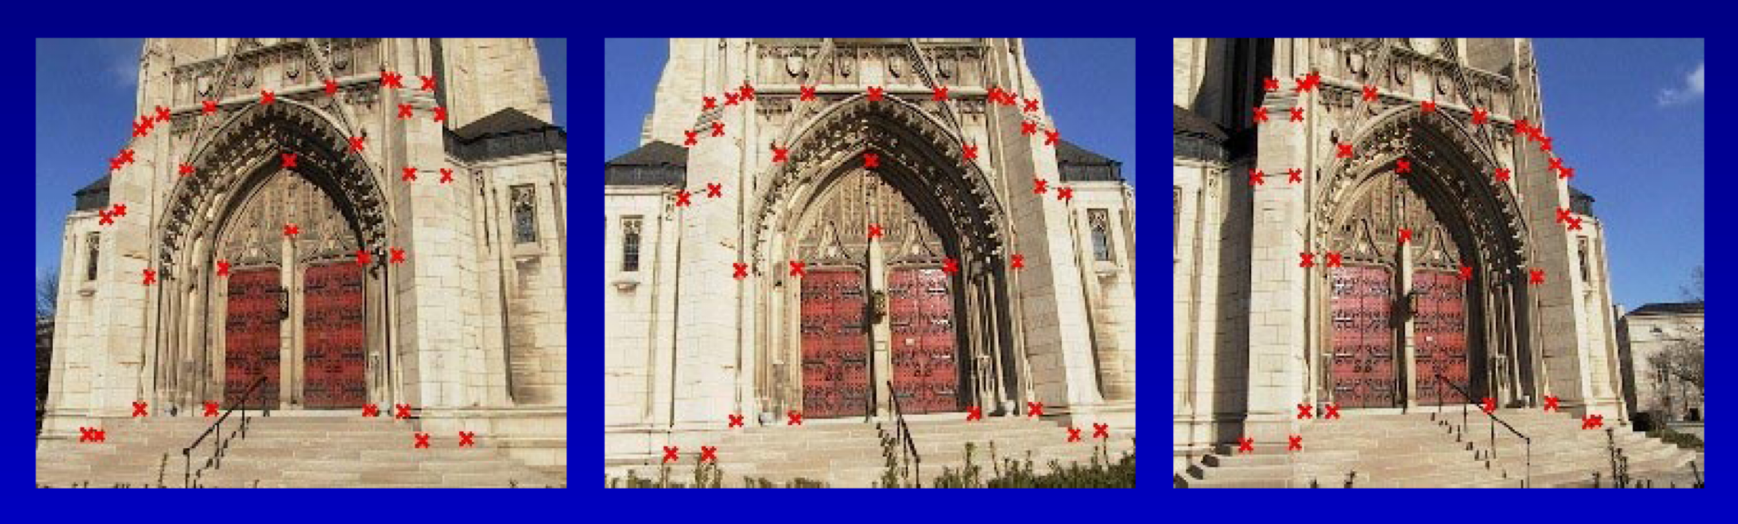
Corners as Feature Points
Edges alone would not be rocognised if object is rotated so not robust
Corners (sharp angles) make good feature points for matching
  Tend to keep sharp angles from different viewpoints
  More stable than edge points alone

Slide 10
Corner Detectors
Lots of corner detectors:
  Moravec
  Zuniga-Haralick
  Kitchen-Rosenfeld
  …
  Harris

Slide 11
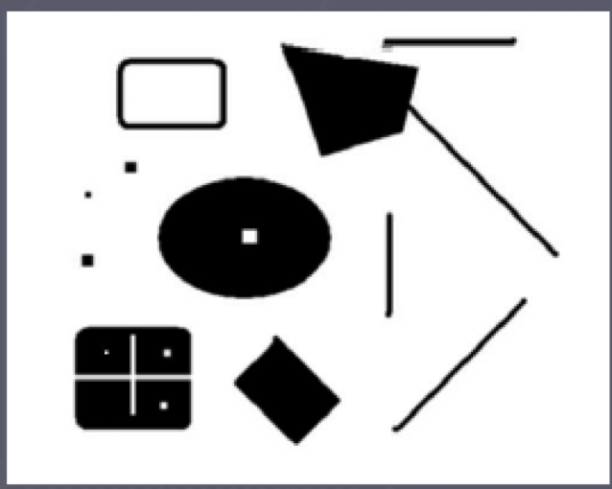
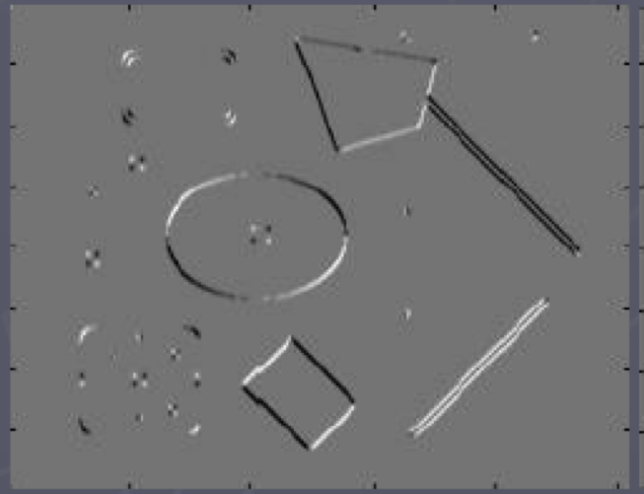
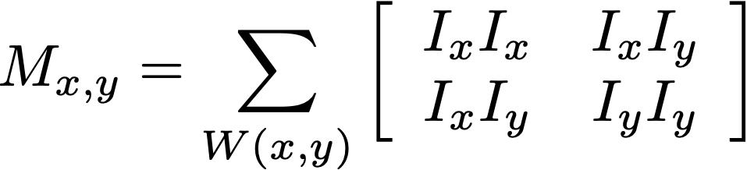

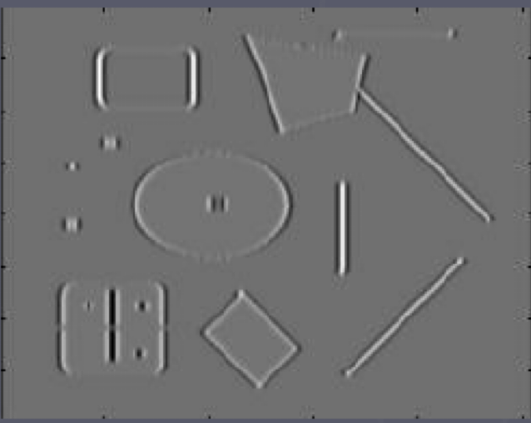
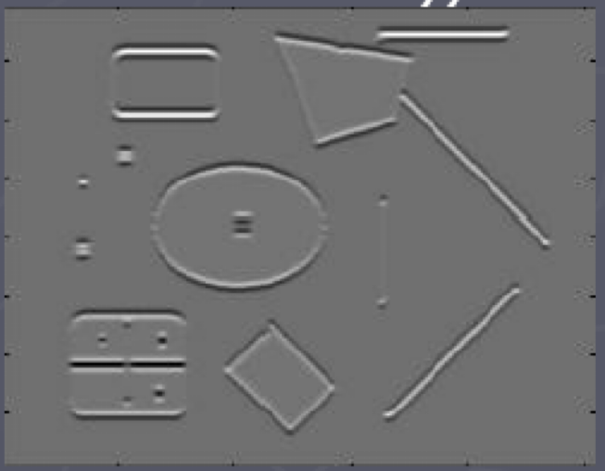


Harris Corner Detector
Takes the second derivative of the edges themselves, finds the eigen values to determine the amount of change that occurred.
Define the following matrix of image derivatives, averaged around point:
Can be noisy, so average in a window around each point
Compute the eigenvectors and eigenvalues of this matrix
Note: this is sometimes called the “Hessian”, but it is not

Slide 12
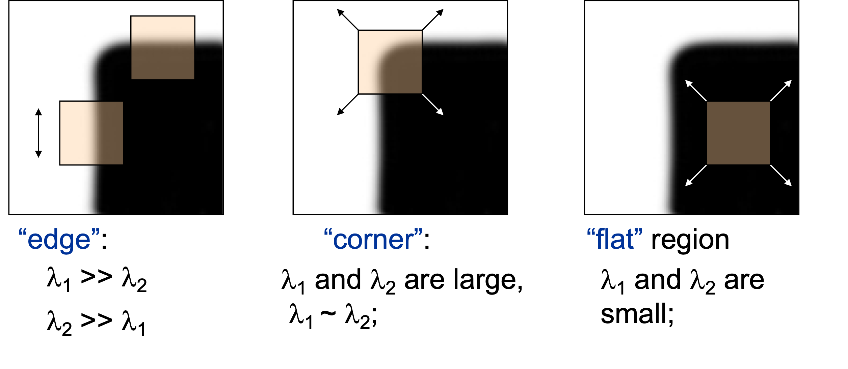
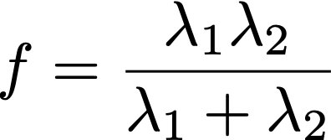

Harris Corner Detector
One way to score
“cornerness”
Harris’s original

Slide 13
Harris Corner Detector
Steps:
  Compute matrix M and “cornerness” f at each pixel using local window around each pixel
  Find points with large response (i.e., threshold f)
  Choose points that are maximal over their local neighborhood
  (non-maximal suppression)

Slide 14
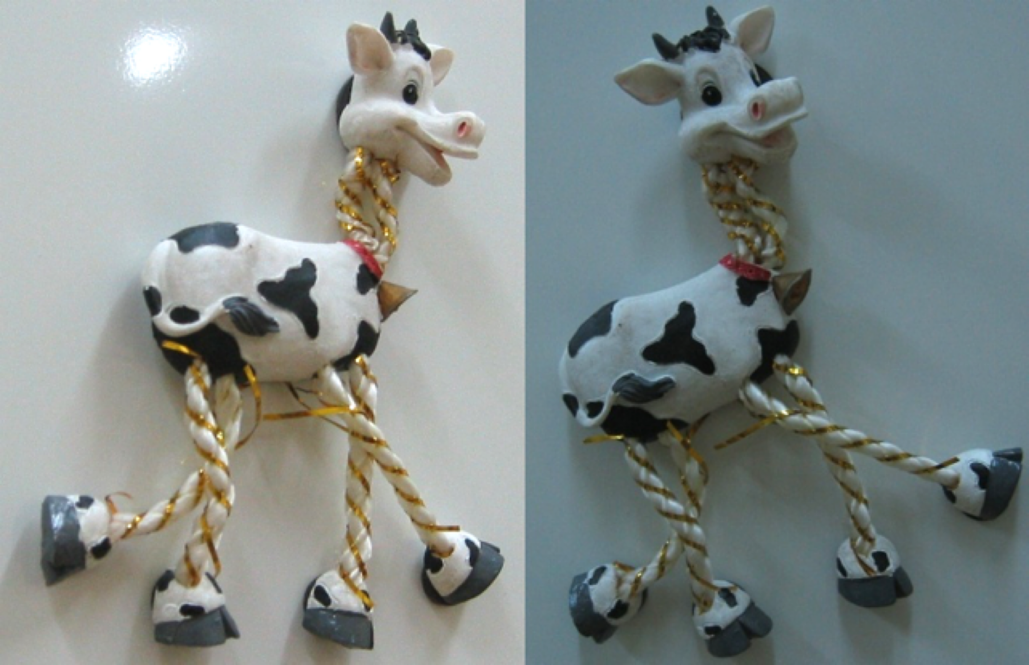
Harris Corner Detector

Slide 15
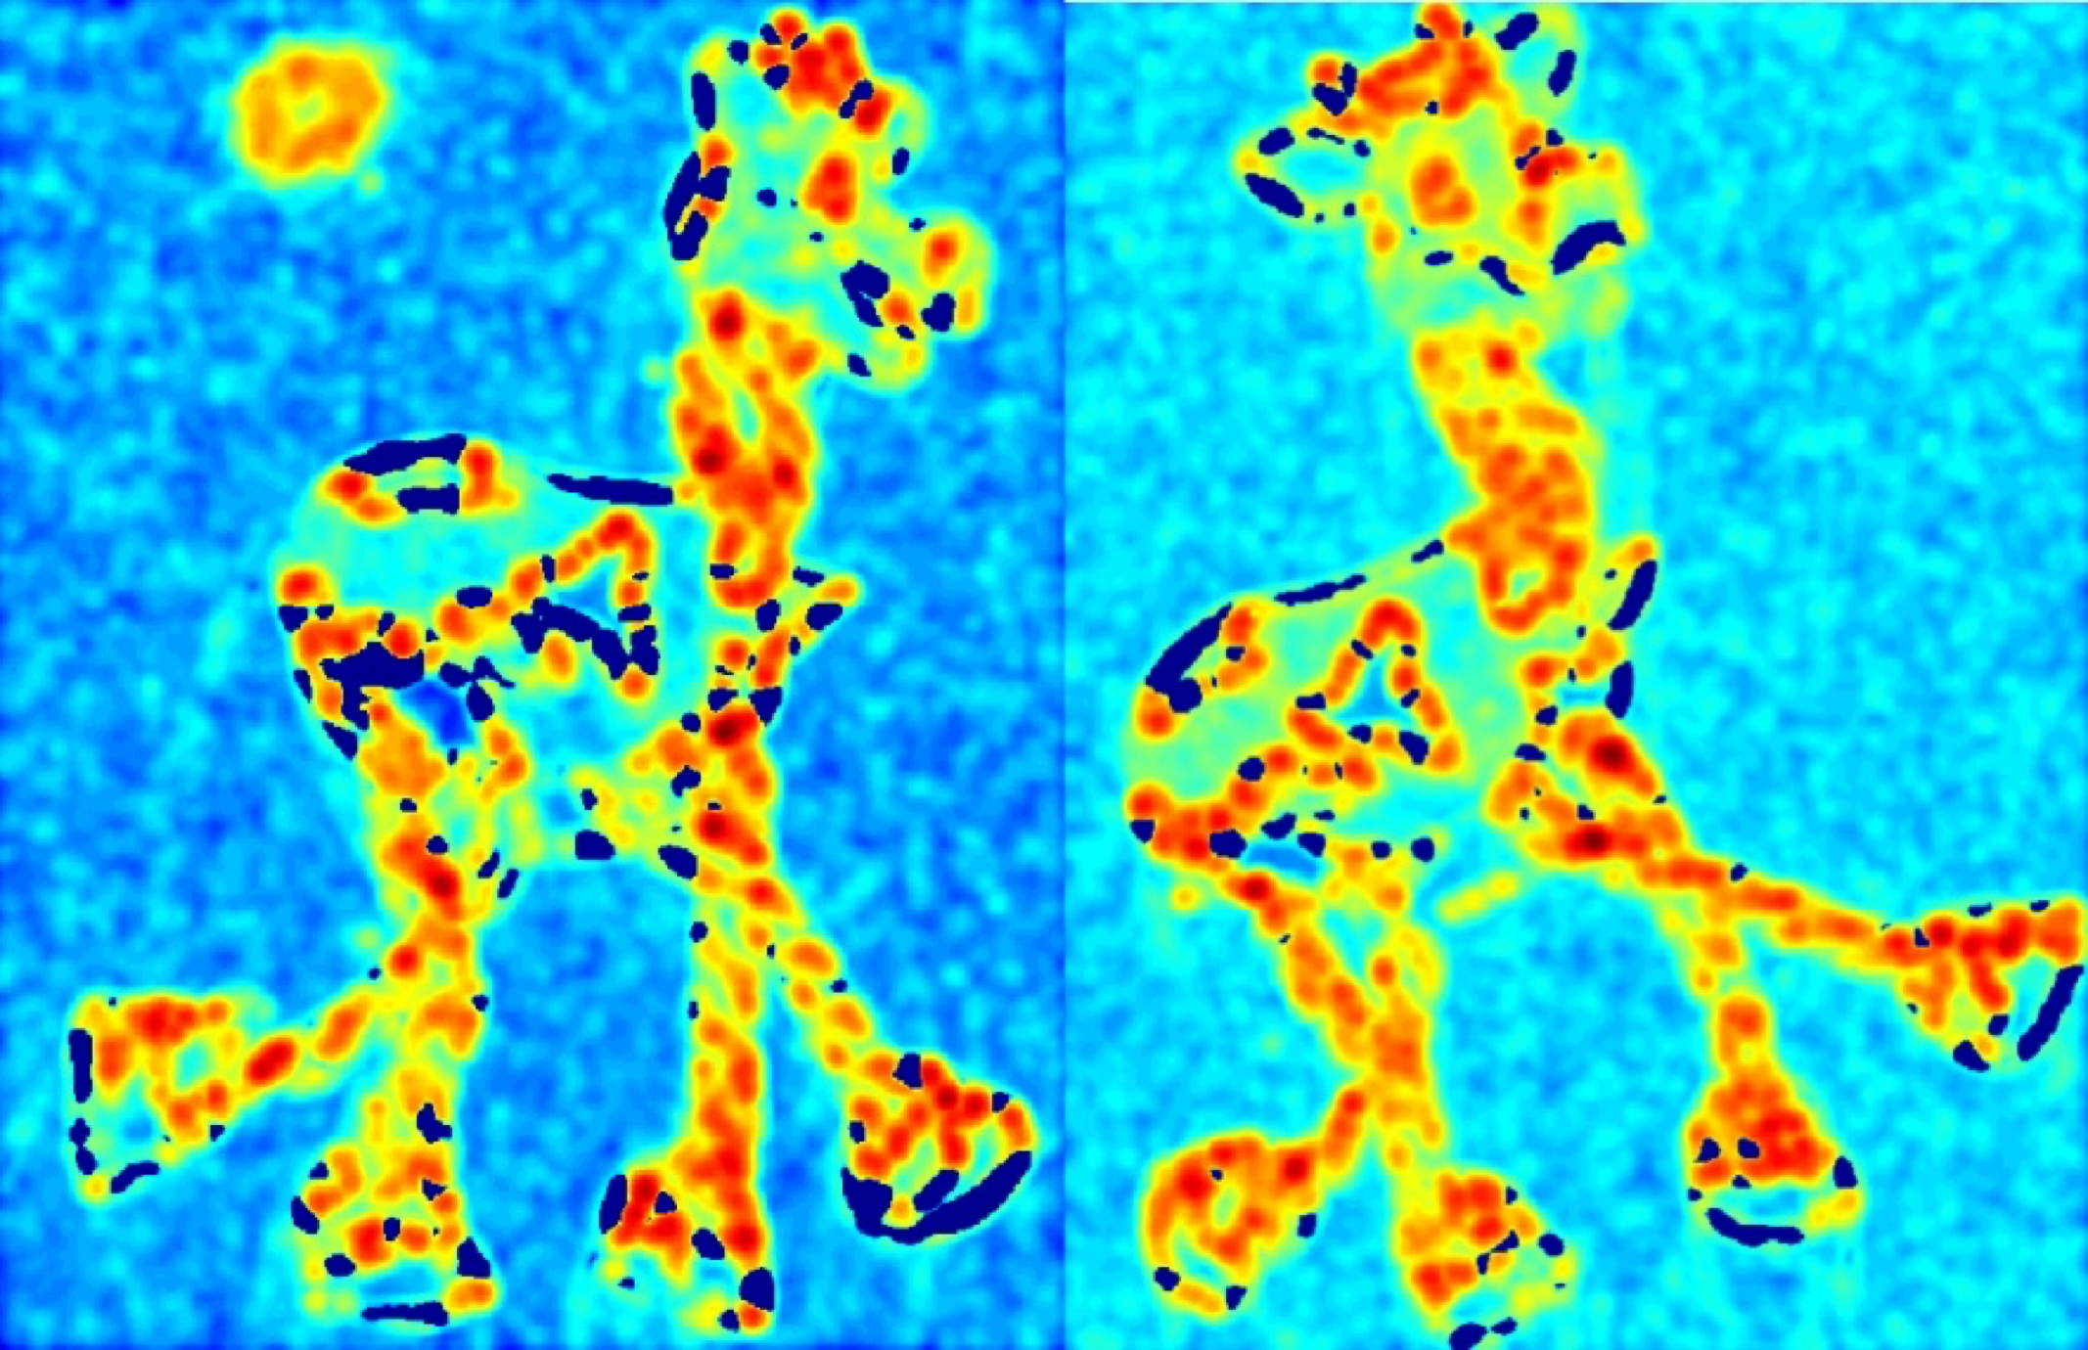
Harris Corner Detector

Slide 16
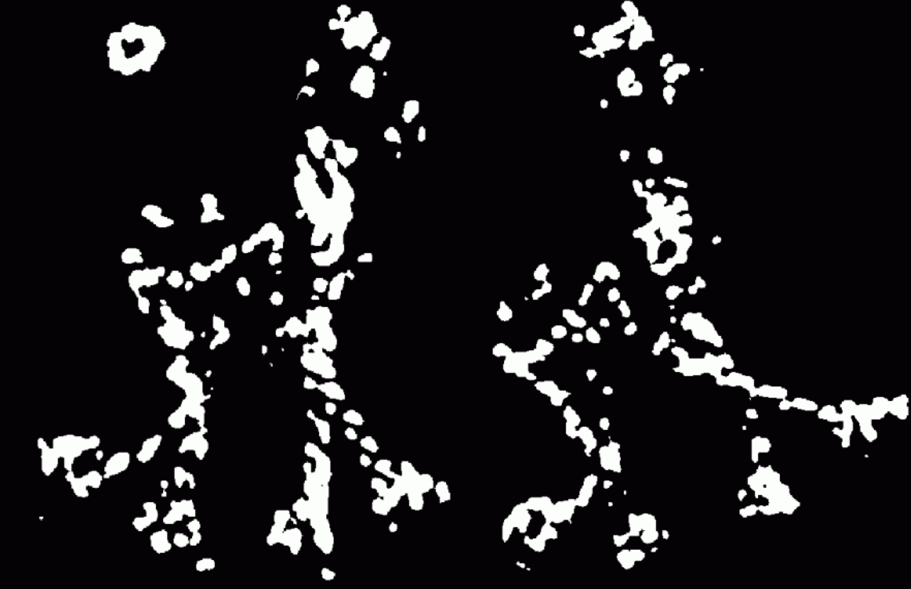
Harris Corner Detector

Slide 17
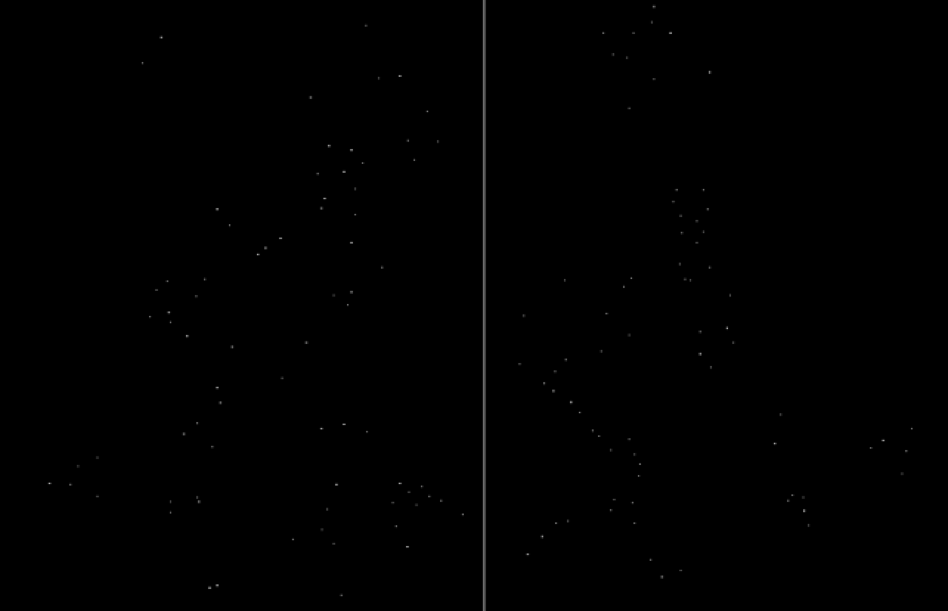
Harris Corner Detector

Slide 18

Harris Corner Detector
Many points in common but not all

Slide 19
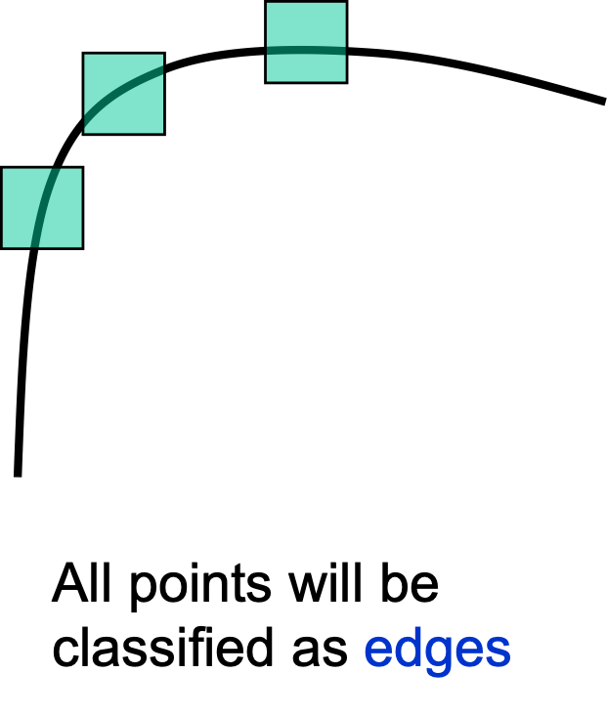
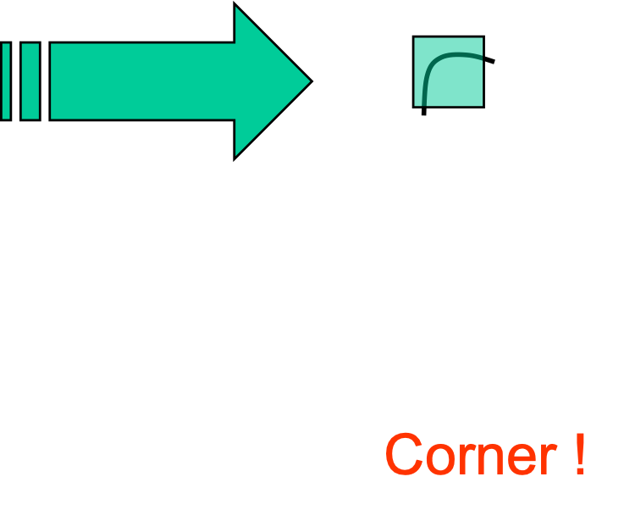
Harris Corner Detector
Invariance checklist:
  Translation
  Rotation
  Scale
  Perspective (mostly)
  Illumination (mostly)

Slide 20
Description
Remember that once you detect a point of interest, you have to extract a feature describing it
Hard to describe a single pixel (just color), so use features in some neighborhood around the point
Simplest: store the neighborhoods and use template-matching approaches:
  convolution/correlation
  SAD, SSD, or other L-norms
  normalized cross-correlation
  etc.

Slide 21
Description
Invariance checklist for pixel-wise neighborhood matching:
  Translation (sub-pixel shifts can still throw things off)
  Rotation
  Scale
  Perspective (mostly)
  Illumination (can be compensated for with some methods)

Slide 22
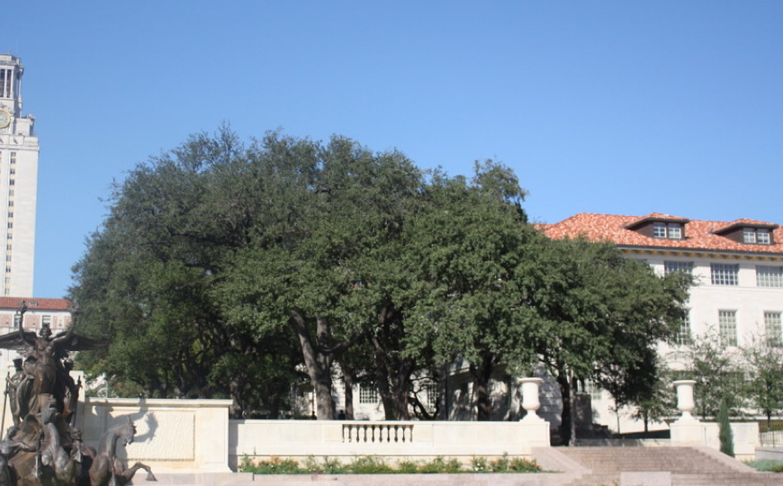
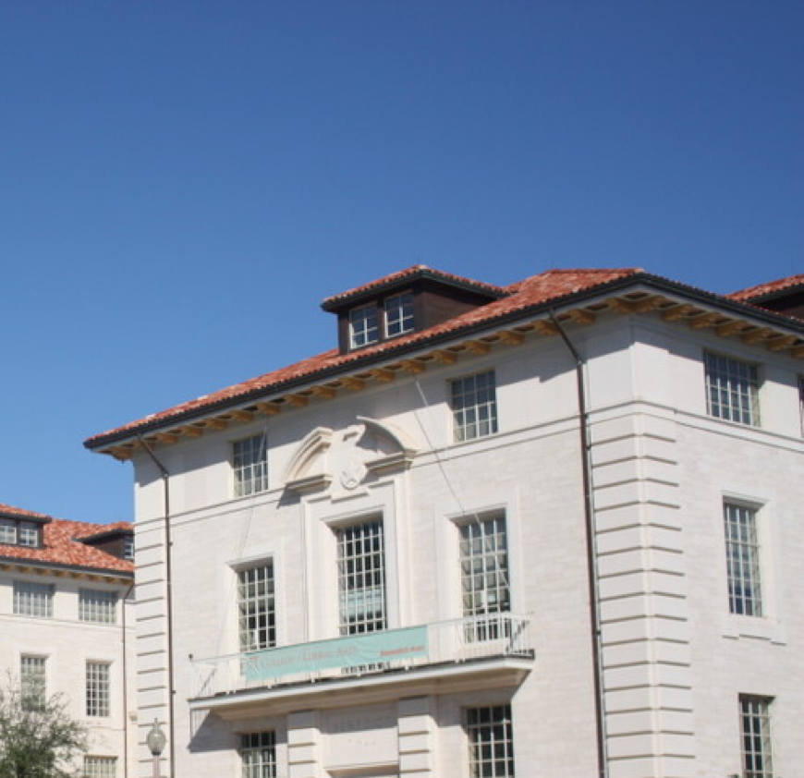
Scale Invariant Feature Points
How can we independently select interest points in each image, such that the detections are repeatable across different scales?
How can we compare local features in ways that are also repeatable across different scales?

Slide 23
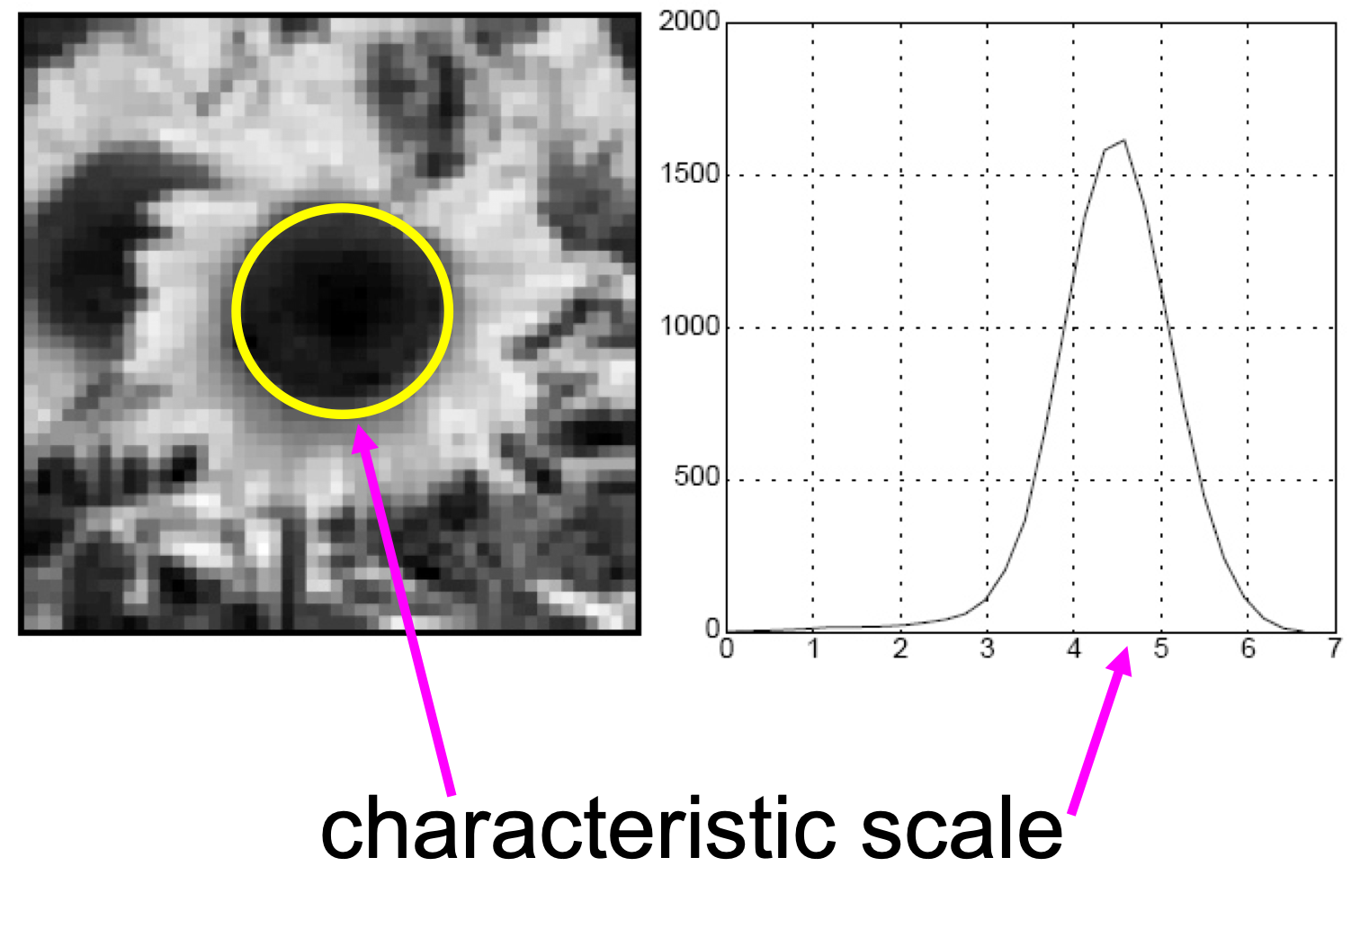
Scale Selection (“Blobs”)
Find points in the image that may be intersting, drop a dot in that center and let the blob grow till it fits all the edges. Based on the radius, we call that
The characteristic size of the flower, so in a smaller sunflower, we have a smaller blob and can match the size smaller to the original flower.
We define the “characteristic scale” as the scale that produces peak of Laplacian response (may be multiple)
Slide credit: Lana Lazebnik

Slide 24
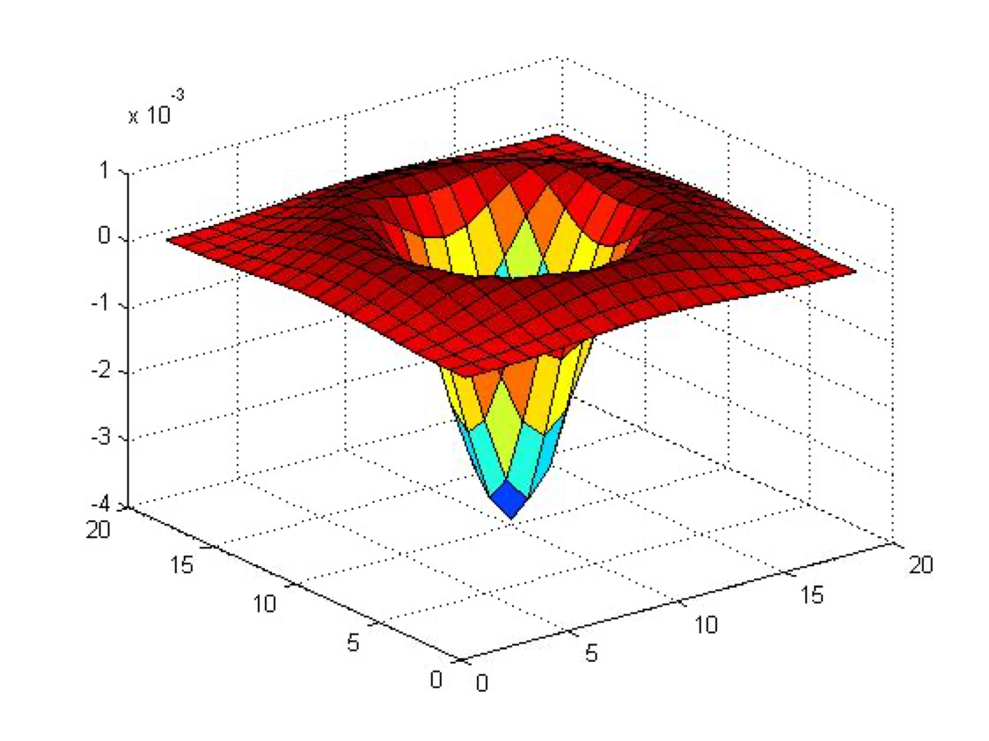

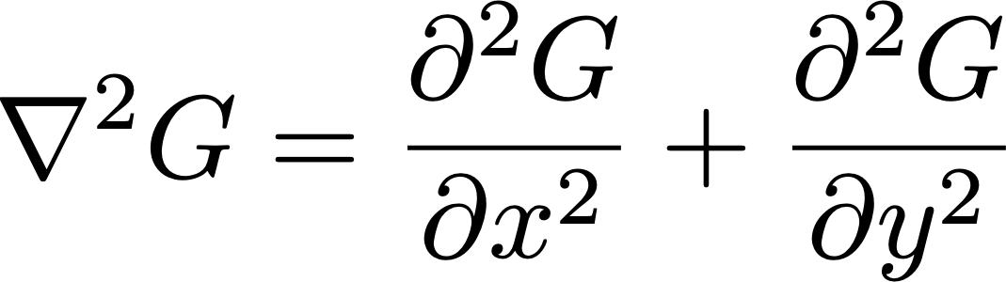
Laplacians of Gaussians

Slide 25
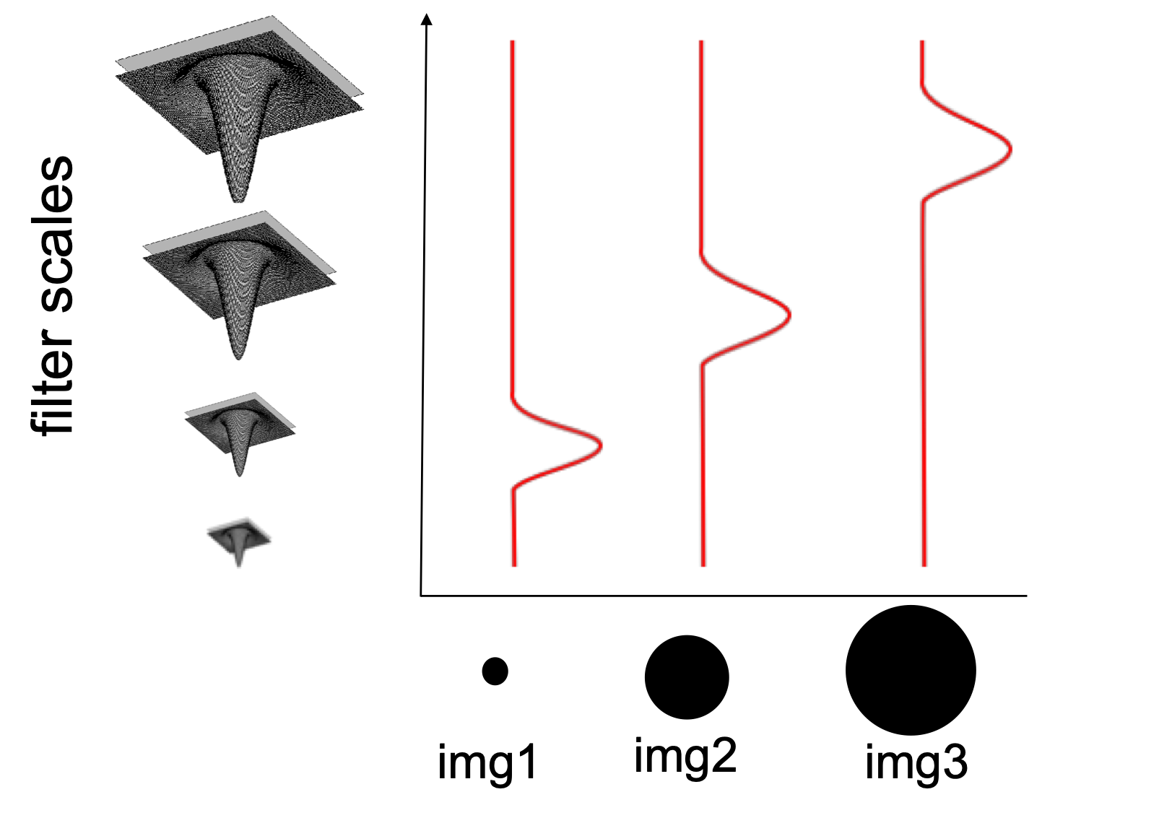
Scale Selection (“Blobs”)
Convolve the entire image with Laplacians of Gaussians of
different scales (std. devs.)
Maximal response fits a local
“blob” in the 2D area

Slide 26
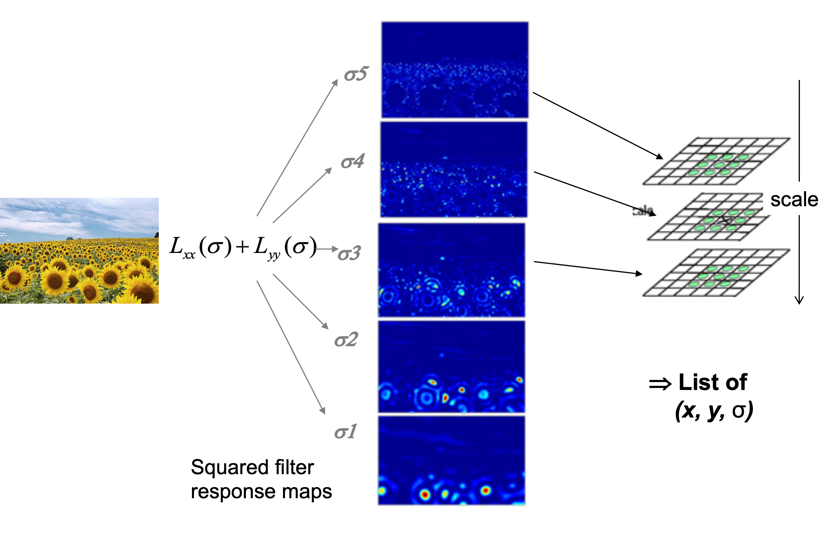
Scale Invariance Feature Points
Interest points are local maxima in both position and scale.

Slide 27
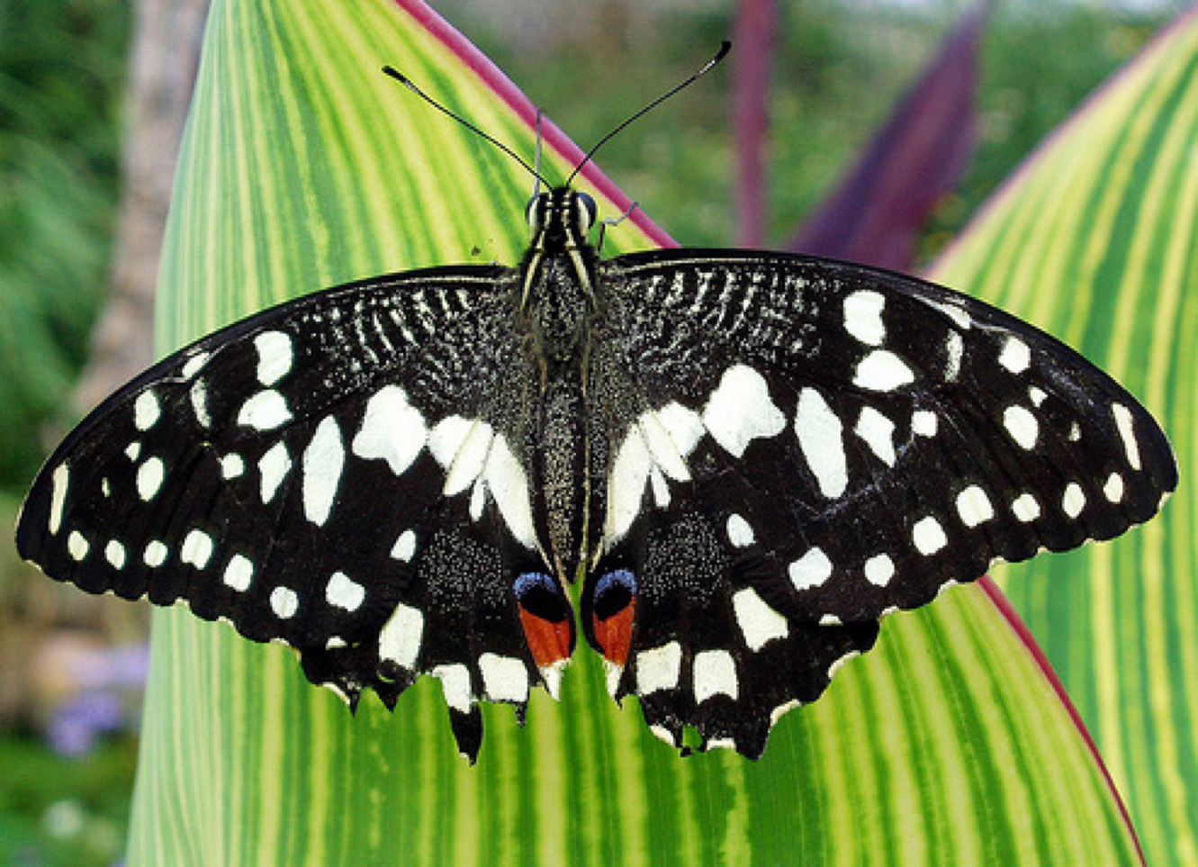
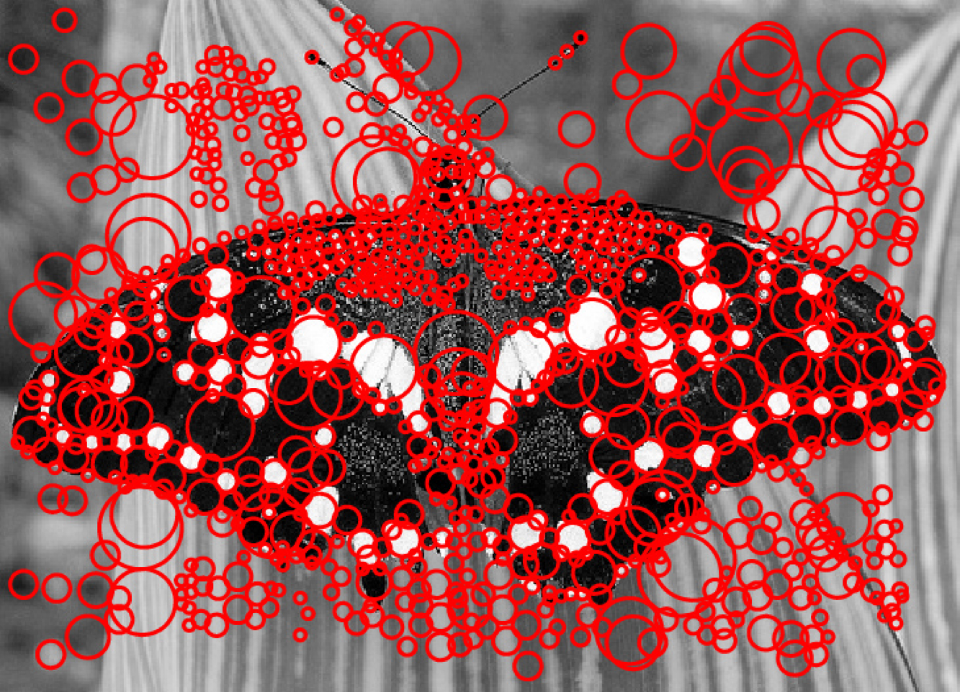
Scale-Space Blob Detector Example
Image credit: Lana Lazebnik

Slide 28
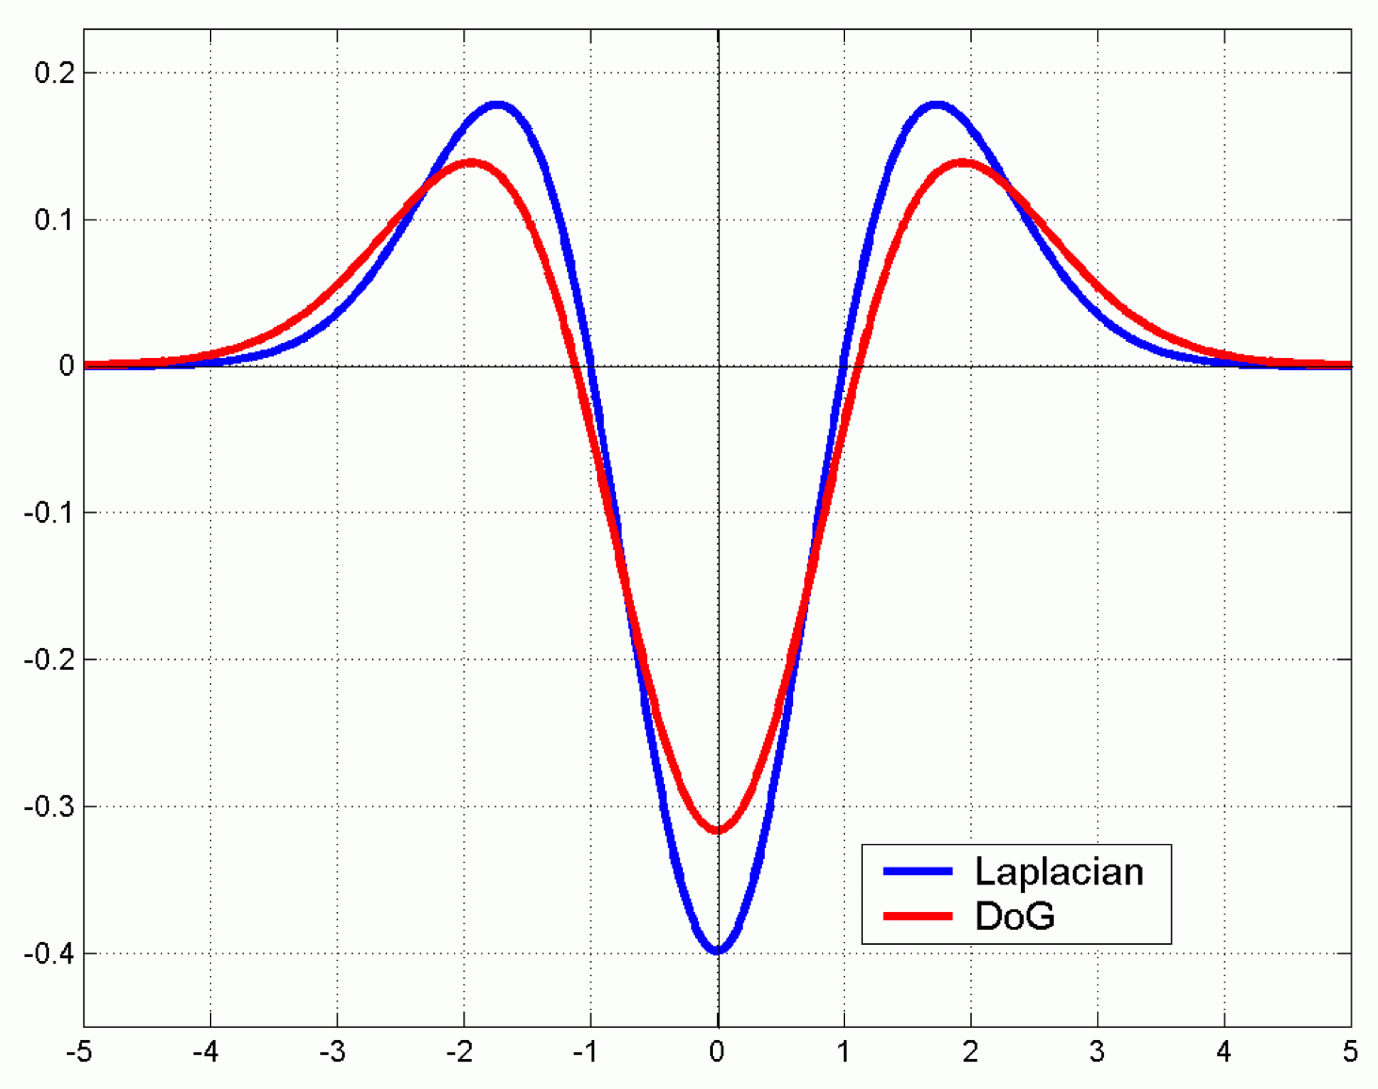
Differences of Gaussians
We can approximate the
Laplacian of Gaussian by a Difference of Gaussians
Can be more efficient to implement
Pro tip: if you really want efficiency, use FFT and convolution theorem

Slide 29
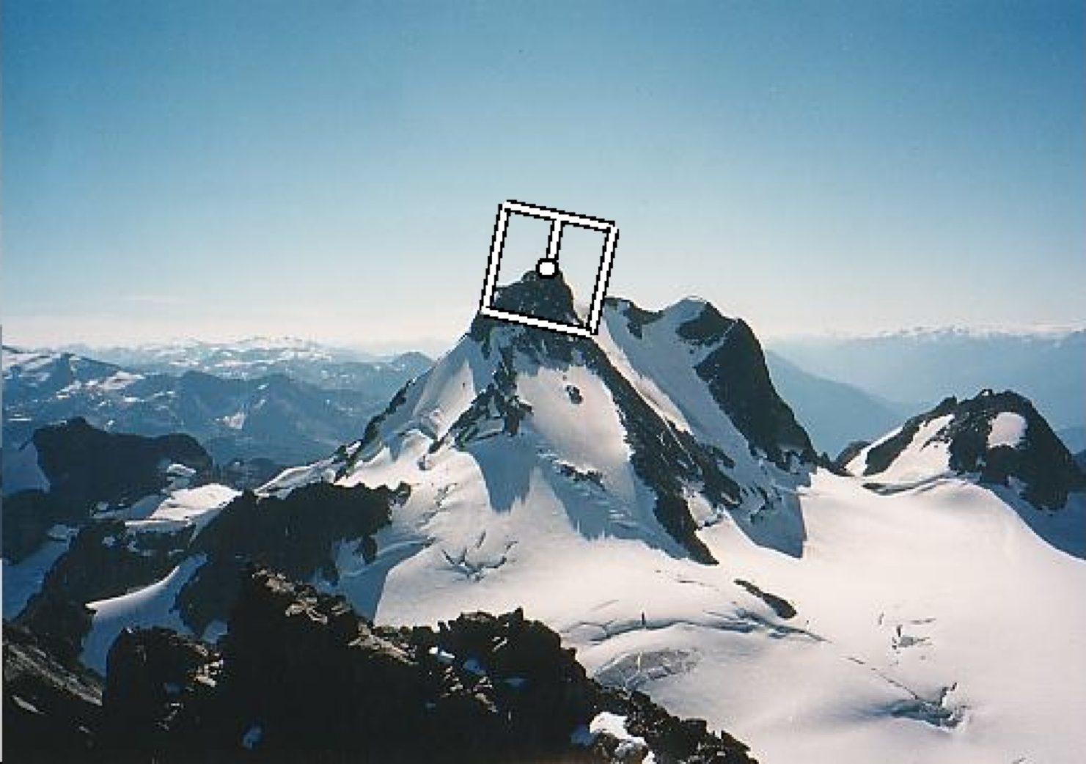
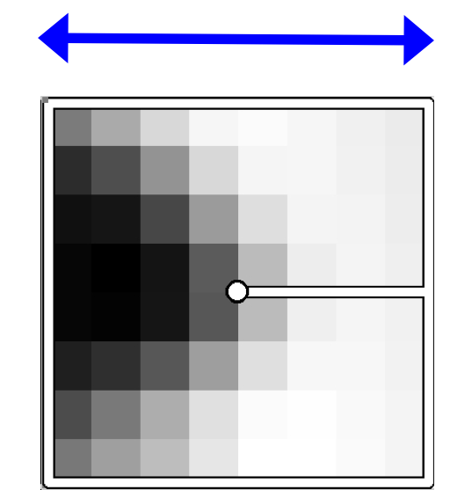
Making Rotation Invariant Features
Which way is the gradient pointing and given that grab the patch around the point, grab this from 2 images, match them so the dominant gradient is pointing
In the same direction before comparing. This makes it rotation invariant. It also doesn’t give onlt the phase but how much to grab so it can be used if scaled.
Rotate patch according to its dominant gradient orientation
This puts the patches into a canonical orientation.

Slide 30
Feature Points
Typical process:
  Detection:
  identify points of interest
  Description:
  extract feature vectors
  Matching:
  determine correspondence

Slide 31
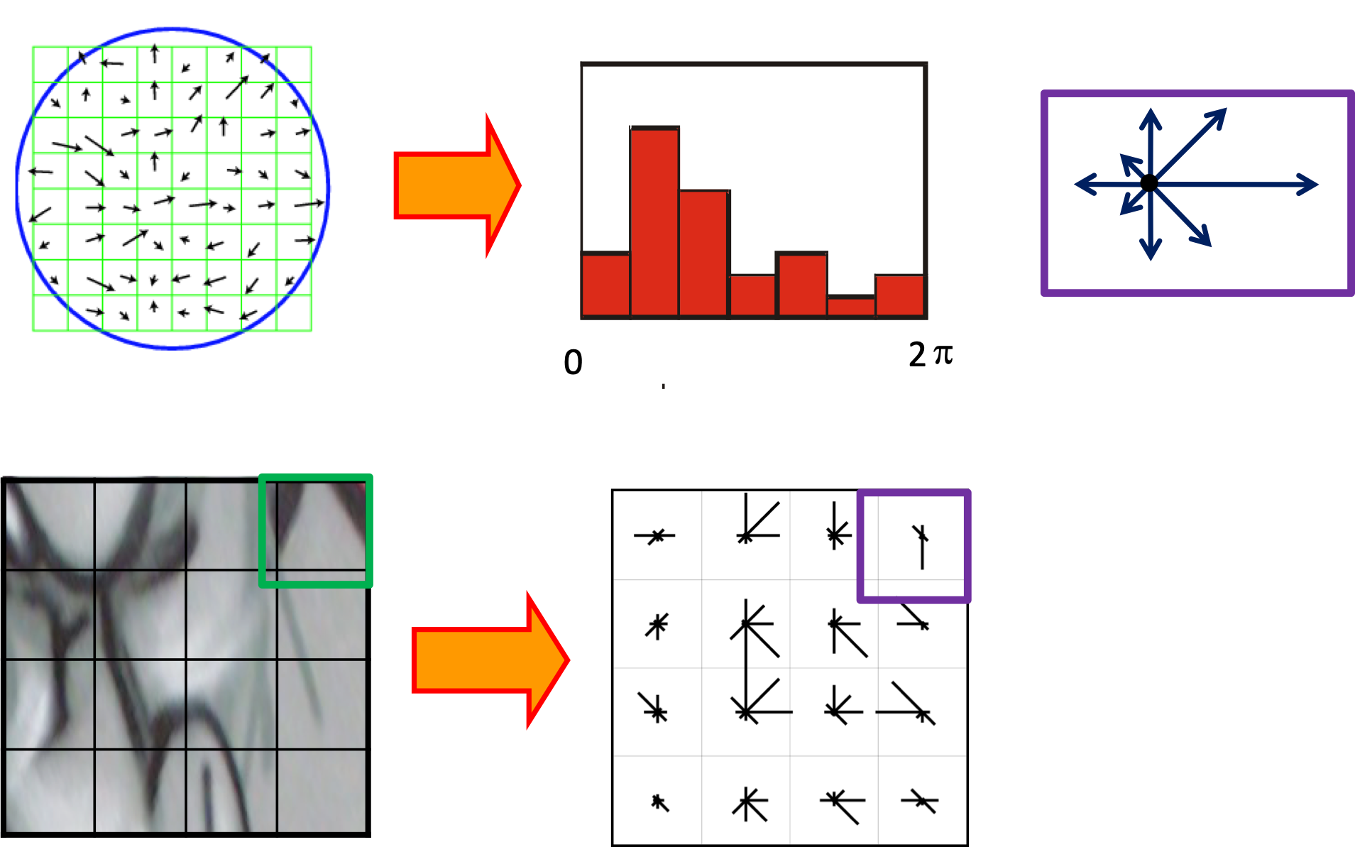
Scale-Invariant Feature Transform (SIFT)
Use histograms to bin pixels within sub-patches according to their orientation.
Find blob, Break the gradient into 8 buns acrosss 16 patches of the image that gives the new histogram for the patches each showing the dominant orientation as we saw before
8 bins, 16 patches, 128 values..

Slide 32
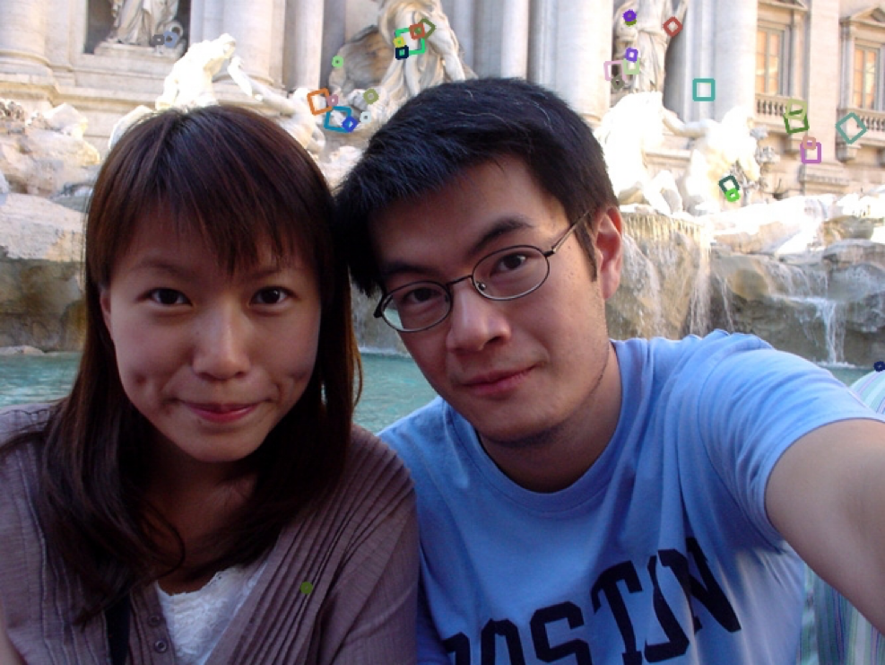
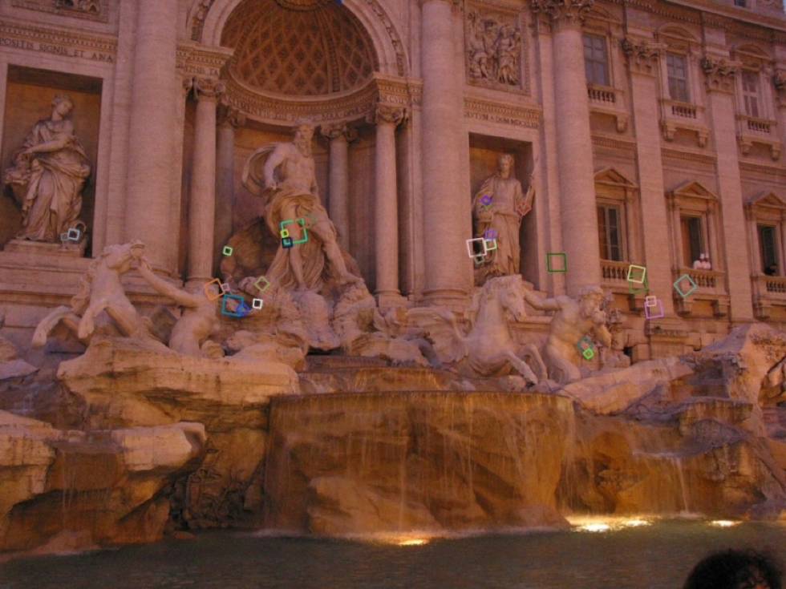
SIFT Descriptor [Lowe, 2004]
We used blob to get points, and sift to describe the points, now how do we match them
Extraordinarily robust matching technique
  Can handle changes in viewpoint
    Up to about 60 degree
    out-of-plane rotation
  Can handle significant changes in illumination
    Sometimes even day vs. night
  Fast and efficient—can run in real time
  Lots of code available

Slide 33
Feature Points
Typical process:
  Detection:
  identify points of interest
  Description:
  extract feature vectors
  Matching:
  determine correspondence

Slide 34
Detour: Comparing Vectors
L1 Norm (Manhattan Distance)
L2 Norm (Euclidean Distance)
L∞ Norm (Chebyshev Distance)
Cosine Similarity (Angle)
many others…

Slide 35
Detour: Comparing Vectors
L1 Norm (Manhattan Distance)
L2 Norm (Euclidean Distance)
L∞ Norm (Chebyshev Distance)
Cosine Similarity (Angle)
$L_{1}\left(v_{1},v_{2}\right)=\sum{v_{2}−v_{1}∨}$
$L_{2}\left(v_{1},v_{2}\right)=\sqrt{\sum{v_{2}−v_{1}∨{}^{2}}}$
$L_{∞}\left(v_{1},v_{2}\right)=max⁡\left(\left|v_{2}−v_{1}\right|\right)$
$sim\left(v_{1},v_{2}\right)=\frac{v_{1}∙v_{2}}{\left\|v_{1}\right\|\left\|v_{2}\right\|}$

Slide 36
Detour: Comparing Vectors
Sift features are mostly mapped using L2 Norms but cosine similarity may also be used.
With use cosine similarity, if the value is closer to 0 then it is not a match, if it sloer to 1 then there is more similarity meaning it may be a match.
L1 Norm (Manhattan Distance)
L2 Norm (Euclidean Distance)
L∞ Norm (Chebyshev Distance)
Cosine Similarity (Angle)
L1(v1,v2) = np.sum(np.abs(v2-v1))
L2(v1,v2) = np.sqrt(np.sum((v2-v1)**2))
L_inf(v1,v2) = np.max(np.abs(v2-v1))
cos_sim(v1,v2) =
np.sum(v1*v2)
np.linalg.norm(v1)*np.linalg.norm(v2)

Slide 37
Example

Slide 38
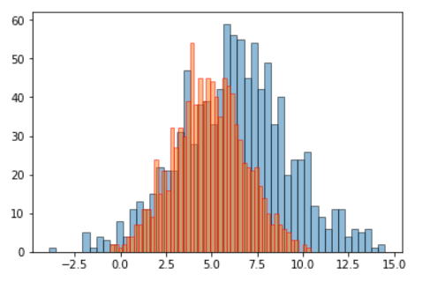
Detour: Comparing Distributions
If there are only have positive values in the vector, then it can be treated as a probability distribution and the following additional metrics can be used:
Wasserstein Distance (Earth Mover)
  If the distributions were piles of dirt, how much dirt would you have to move to make one distribution look like the other?
Kullback–Leibler divergence
many others…
https://stats.stackexchange.com/questions/339313/comparing-distributions-bayesian-decision-analysis

Slide 39
Matching Features
SIFT features are usually matched using L2 Norm, but cosine similarity is also often used.

Slide 40
Let’s Try It in OpenCV!
Use blob to grap dominant points, use gradients to find the description, when we have sift, we then use L2 or cosine comparison to match the image to another.

Slide 41
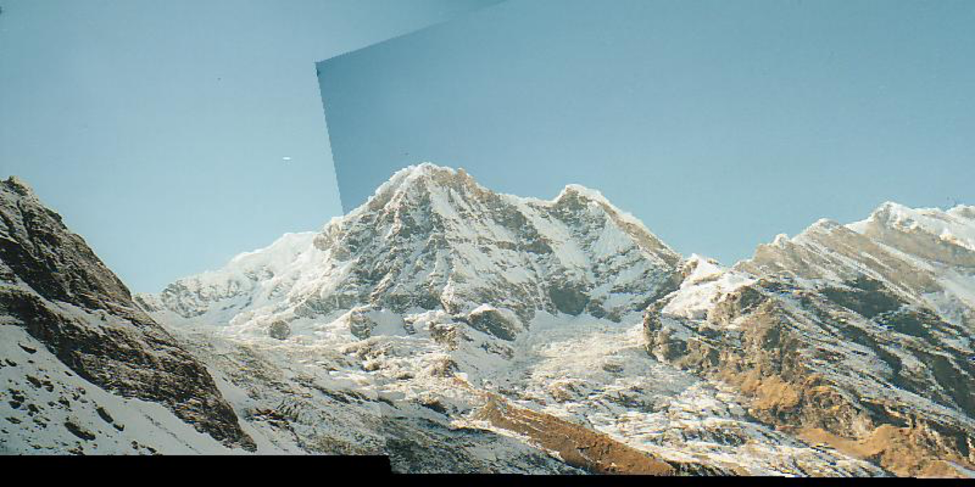
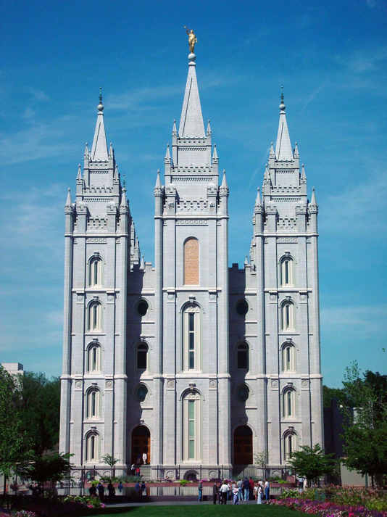

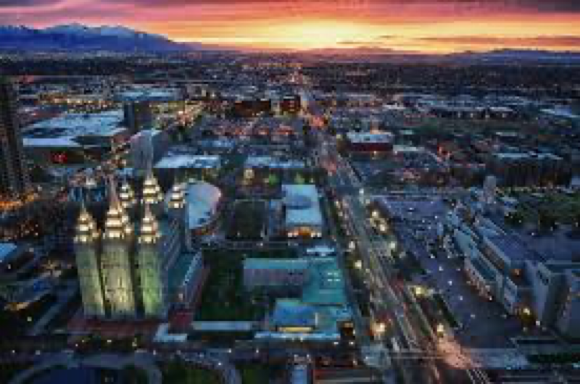

Applications of Local Invariant Features
Wide baseline stereo
Motion tracking
Panoramas
Mobile robot navigation
3D reconstruction
Recognition
…

Slide 42
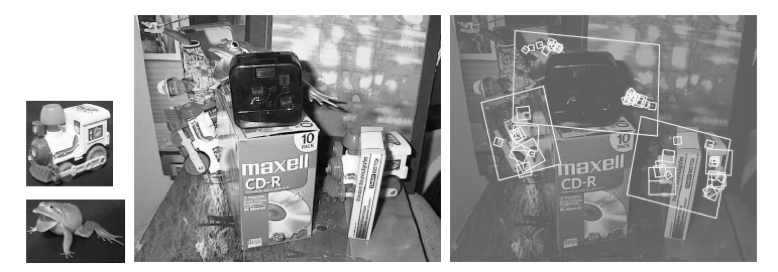
Object Detection
Let each SIFT feature point vote for object location
similar to Generalized Hough Transform

Slide 43
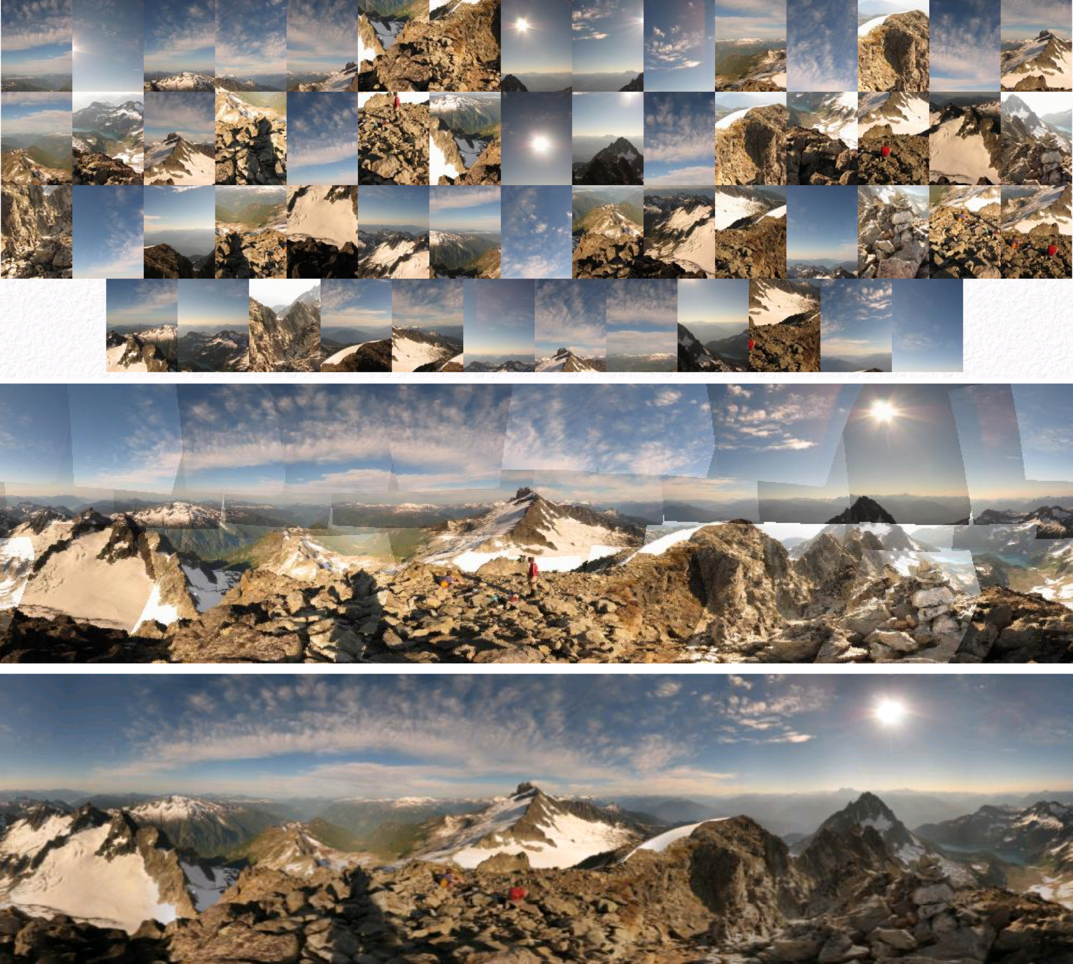
Automatic Mosaicing

Slide 44
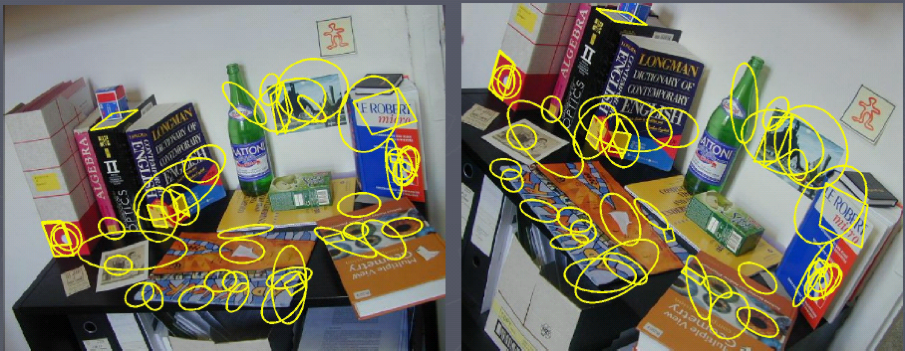
Wide Baseline Stereo

Slide 45
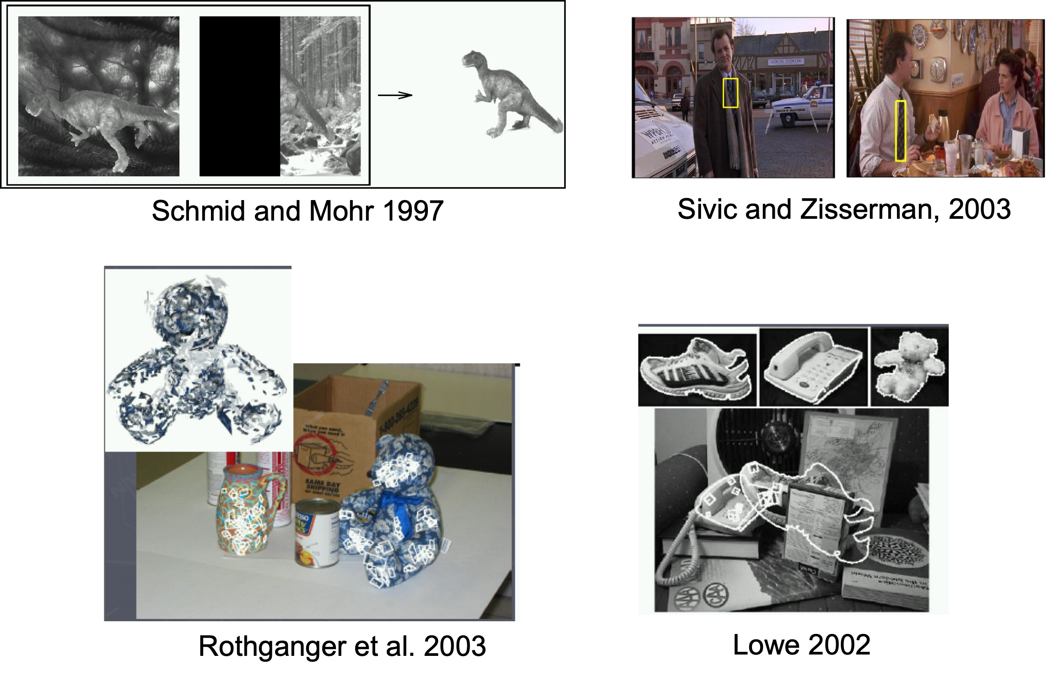
Recognition of Specific Objects Scenes

